Slide 1
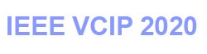
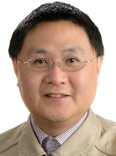

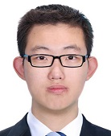
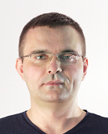
2020 IEEE International Conference on Visual Communications and Image Processing (VCIP)
Learned Image and Video Compression with
Deep Neural Networks
Dong Xu
University of Sydney, Australia
Guo Lu
Beijing Institute of Technology, China
Ren Yang
ETH Zurich, Switzerland
Radu Timofte
ETH Zurich, Switzerland
Notes:
Hello everyone, welcome to the tutorial of Learned Image and Video Compression with Deep Neural Networks. The organizers of this tutorial are Prof. Dong Xu at the University of Sydney, Australia, the assistant prof. Guo Lu from the Beijing Institute of Technology, China, and me Ren Yang a PhD student at the computer vision lab of ETH Zurich, Switzerland, and my advisor Dr. Radu Timofte, who is a lecturer and group leader of our lab.

Slide 2

2020 IEEE International Conference on Visual Communications and Image Processing (VCIP)
Learned Image and Video Compression with
Deep Neural Networks
Part 1 Learned Image Compression
Ren Yang
Ph.D. student
Radu Timofte
Lecturer, Group leader
Computer Vision Laboratory
ETH Zurich, Switzerland
Notes:
The first part is about the learned image compression, will be presented by me and Dr. Radu Timofte.

Slide 3
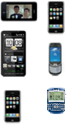
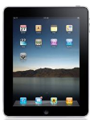
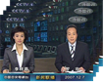
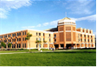

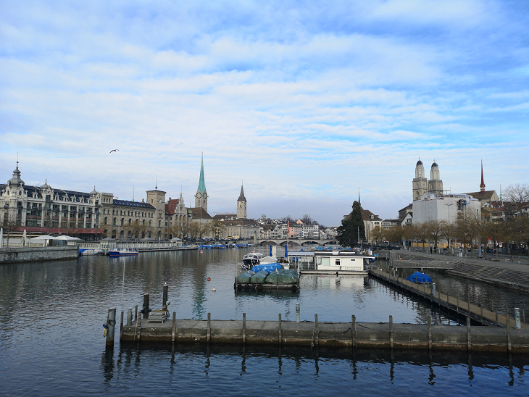
Large amount of
high-resolution images/videos
Terminal devices
Limited
bandwidth
Limited storage
7296 x 5472 = 39,923,712 pixels
Uncompressed image: 39,923,712 x 3 = 120 MB
Uncompressed video (60 fps): 120 MB x 60 = 7.2 GBps (18s needs 128 GB)
Lossless compression (.png): 44 MB
Lossy compression (.jpg): 9 MB
Image/video compression plays an important role in
multimedia streaming, online conference, data storage, etc.

Slide 4
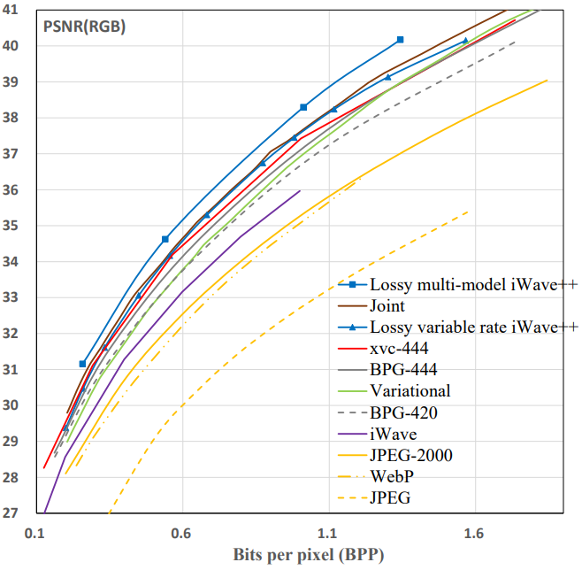
Rate-distortion trade-off
Metrics: PSNR, (MS-)SSIM, NIMA, LPIPS, user studies, etc.
Higher quality
(lower distortion)
Target
Better quality at the same bit-rate
Lower bit-rate at the same quality
Higher bit-rate (file size)

Slide 5
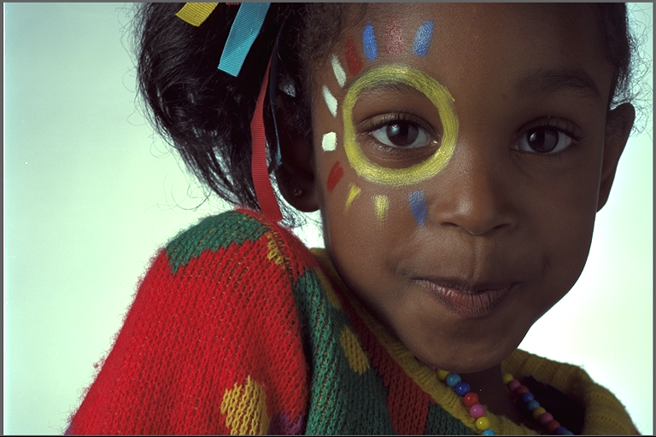
Traditional Image Compression
Frequency domain
(coefficients)
Quantized coefficients
Quantized coefficients
Classical Architecture:
Standards: JPEG (DCT + Huffman), JPEG2000 (DWT + Arithmetic coding), BPG (HEVC), …
Example: JPEG compression framework
Transform
Quantization
Entropy encoding
Bit-stream
Entropy decoding
Inverse Transform
xxx.jpg
8x8 blocks
DC
Zigzag
scan
DPCM
Entropy
encoder
DCT
Q
Encoder
RLC
AC
Raw image
Quantization
table
Table
specification
Bit-stream
8x8 blocks
DC
Zigzag
scan
DPCM
Entropy
decoder
Decoder
IDCT
IQ
AC
RLC
Compressed image
Quantization
table
Table
specification
Notes:
We first briefly introduce the traditional image compression algorithms. In traditional compression, an image is first transformed into the frequency domain via an invertible transform, and the coefficients are quantized and then encoded via entropy coding, e.g., Huffman coding or arithmetic coding. At the decoder side, the bit-stream is first decoded to obtain the quantized coefficients, and then they are inversely transformed to reconstruct the compressed image. The JPEG, JPEG 2000 and BPG are typical traditional image compression standards. JPEG uses DCT transform with Huffman coding, JPEG 2000 uses the wavelet transform with arithmetic coding. The arithmetic coding is theoretically achieve cross entropy. BPG is based on the intra-mode of the video coding standard HEVC. This figure shows an example of the JPEG compression framework.

Slide 6
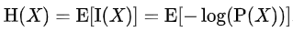
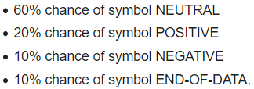
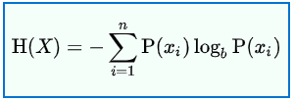
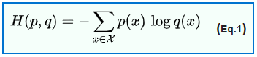
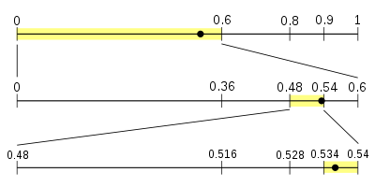
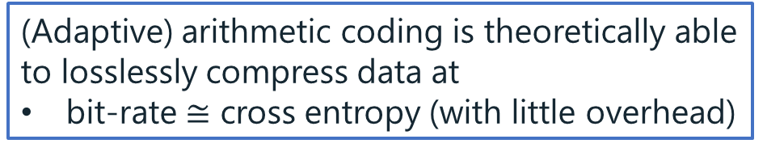
Entropy coding
Entropy:
Arithmetic coding:
Cross entropy:
real
estimated
(Adaptive) arithmetic coding is theoretically able to losslessly compress data at
bit-rate $≅$ cross entropy (with little overhead)
8 bits
0.10001010 (0.5390625 decimal)
Adaptive arithmetic coding:
Changing the frequency (or probability) tables while processing the data.

Slide 7
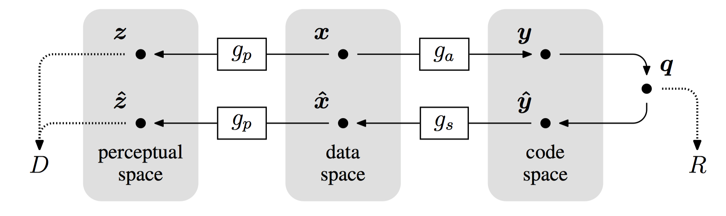
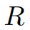
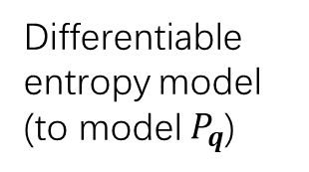
Learned Image Compression
End-to-end trainable
Basic architecture ^{[1]}:
Deep neural network
Uncompressed image
Latent representation
(Differentiable) quantization
Quantized y
Differentiable entropy model
(to model $P_{q}$)
Compressed image
Deep neural network
[1] Ballé, Johannes, et al. "End-to-end optimized image compression." in ICLR. 2017.
Notes:
In the following, we introduce learned image compression, which adopts end-to-end deep neural networks, and therefore can be trained in an end-to-end manner. This shows a basic architecture, in which x is the raw image. ga and gs are the encoding and decoding networks, which are both neural networks and are called an autoencoder. y is the latent representation, which represents the information of x but is usually with smaller size than x. The y is quantized and encoded into the bit-stream with the bit-rate of R. At the decoder size, the quantized y (y_hat) is decoded from the bit-stream and fed into the decoding network to reconstruct the compressed image x_hat. In compression, there is a trade-off between bit-rate and distortion. Therefore, the loss is designed as R + lambda D. lambda is the hyperparameter to balance the rate and distortion terms. To make the whole framework end-to-end trainable, we have to use a differentiable quantization method and design a differentiable entropy model. In arithmetic coding, we need a probability function P to encode the latents into bit-stream, and the bit-rate are theoretically equal to the cross entropy of P. The entropy model is used to model the probability function of y_hat, and the bit-rate R can be estimated as the cross entropy of P. Next, we will introduce popular learned image compression methods.

Slide 8
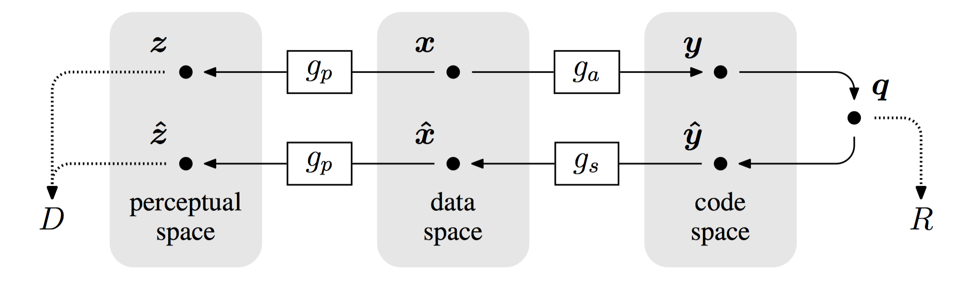
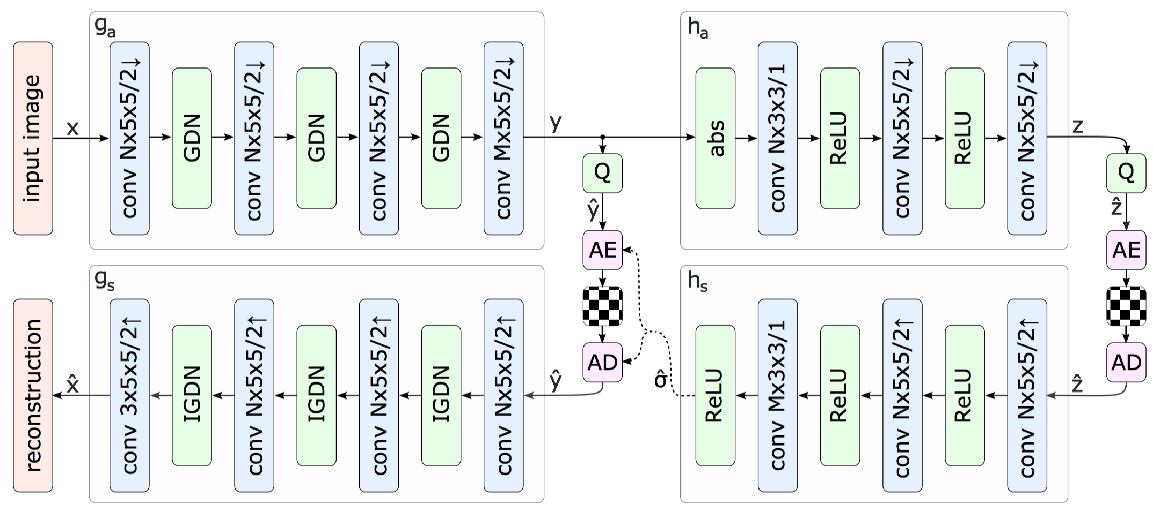
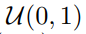
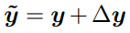
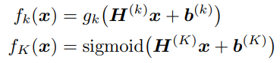
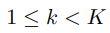
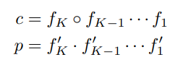
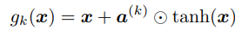
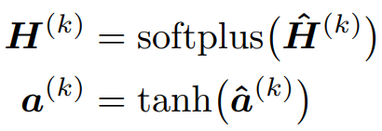
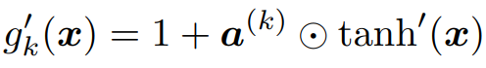
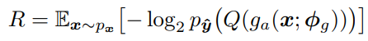
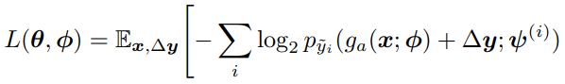
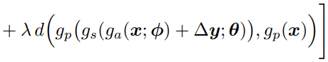
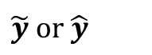
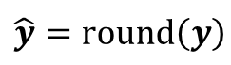
Learned Image Compression
CNN transformer + factorized entropy model ^{[1]}
Training: differentiable quantization
$$\hat{y}=round\left(y\right)$$
Inference: quantization (not differentiable)
$$\tilde{y} or \hat{y}$$
differentiable entropy
estimated bit-rate
bit-rate
trade-off
distortion
Optimized in an end-to-end manner
[1] Ballé, Johannes, et al. "End-to-end optimized image compression." in ICLR. 2017.
Notes:
This method utilizes a CNN transformer and a factorized entropy model. The encoder and decoder networks (ga and gs) are convolutional neural networks. There are 4 x2 down-sampling in the encoder, and also 4 x2 up-scaling in the decoder. The latent representation y is quantized as y_hat, but the quantization (used in inference) is not differentiable. Here, they release the quantization as adding a noise with the uniform noise (mean = 0, width = 1, [-0.5, 0.5]), which is the same as the quantization noise. Next is the differentiable entropy model, which is used to estimate the probability function of y_hat for arithmetic coding. Here c is the cumulative distribution (probability) function, which must be a increasing function with the value ranging from 0 to 1. The pdf is the derivative of it. F_k is designed like this, x can be either y_tilde or y_hat depending on you’re training or testing, H and b are the parameters to be learned. It can be seen that f_k consists of matrix multiplication, so it is called the factorized entropy model. Given the pdf, the bit-rate can be estimated, the loss function can be obtained as this, where lambda balances the rate-distortion trade-off. Since all components in the framework are differentiable, it can be trained in an end-to-end manner.

Slide 9
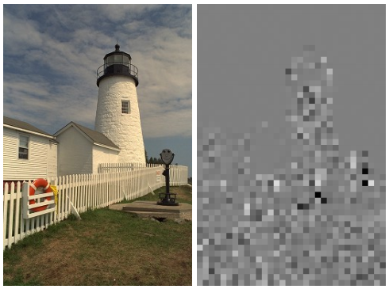
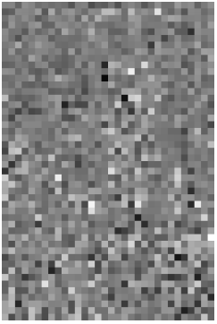
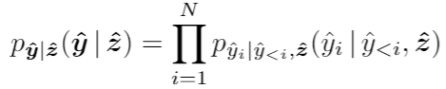
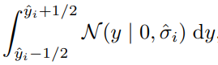
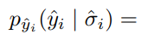
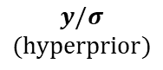
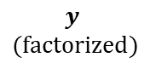
Learned Image Compression
CNN transformer + hyperpiror entropy model ^{[2]}
differentiable quantization
differentiable
entropy model
less dependency
(less redundancy)
discretized Gaussian distribution
$$y$$
$$(factorized)$$
$$y/σ$$
$$(hyperprior)$$
[2] Ballé, Johannes, et al. "Variational image compression with a scale hyperprior." in ICLR. 2018.
Notes:
Based on the factorized model, Balle et al. proposed a hyper-prior entropy model, which has the hyper transformer network ha and hs. Ha transforms y to a hyper-prior z, z is quantized and compressed via the factorized model, and hs transforms the quantized z (z_hat) a sigma matrix, which has the same dimension as y/y_hat. The pdf of each element in y_hat (y_hat_i) is modelled as the Gaussian distribution with the mean of zero and the standard deviation as sigma_i. Since sigma is generated from z, p(y|sigma) can be understood as p(y|z). Given the hyper-prior z, y can be more efficiently compressed and the gain is more than the overhead of the bits for compressing z. This figure visualizes the latent y in the factorized and hyper-prior models. It can be seen that in the factorized model, there is clearly visible structure around edges and textured regions, indicating that a dependency structure which is not represented in the factorized prior. Right: latents y divided elementwise by their standard deviation sigma. Note how this reduces the apparent structure, indicating that the structure is captured by the new prior.

Slide 10
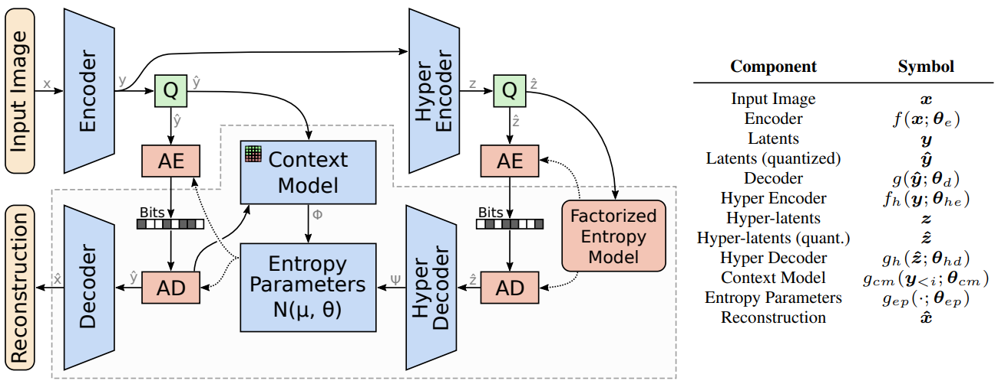
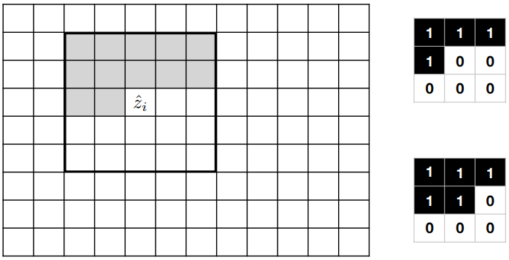
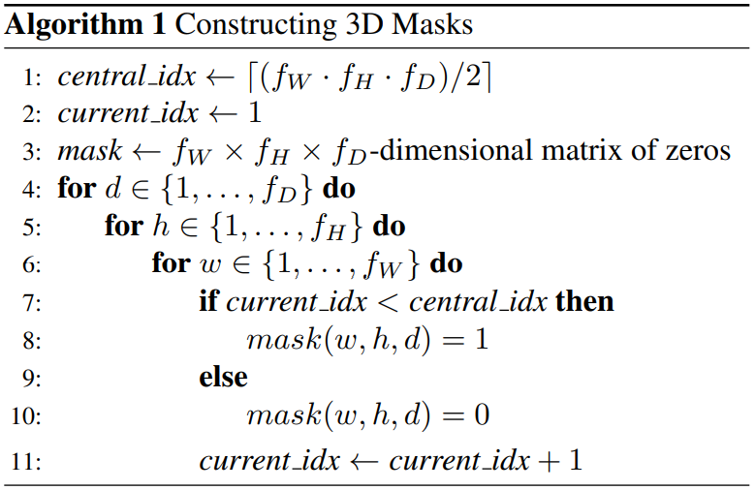
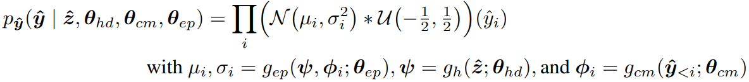
Learned Image Compression
CNN transformer + autoregressive entropy model ^{[3]}
Mask CNN ^{[4]}
first layer
other layers
Due to the chain rule:
[3] Minnen, David, et al. "Joint autoregressive and hierarchical priors for learned image compression." in NeruIPS. 2018.
[4] Mentzer, Fabian, et al. “Conditional Probability Models for Deep Image Compression”, in CVPR, 2018.
Notes:
Later, Minnen et al., proposed to integral an autoregressive prior into the entropy model. Due to the chain rule, the PMF of the matrix y can be expressed as the product of p(y1), p(y2|y1), …. Therefore, p(y|z) can be re-written as the product of p y_i conditioned on previous elements y<i and z. This pmf is also modeled as gaussian distribution, with sigma and mu coming from both z and previous elements y<i. The way to achieve the autoregressive model is introduced in Fabian’s paper, that is, the mask cnn is used as the context model shown in the figure. In the first layer, the kernel weights of the current and following positions are all set to 0. This way, the output at the current position only depends on its previous elements. From the second layer, the weight at the current position can be set to 1, since the output from the first layer at this position only uses previous information. So set this position to 1, it still can be ensured that only previous information is used. Similarly, this is the algorithm to generate 3D mask CNN.

Slide 11
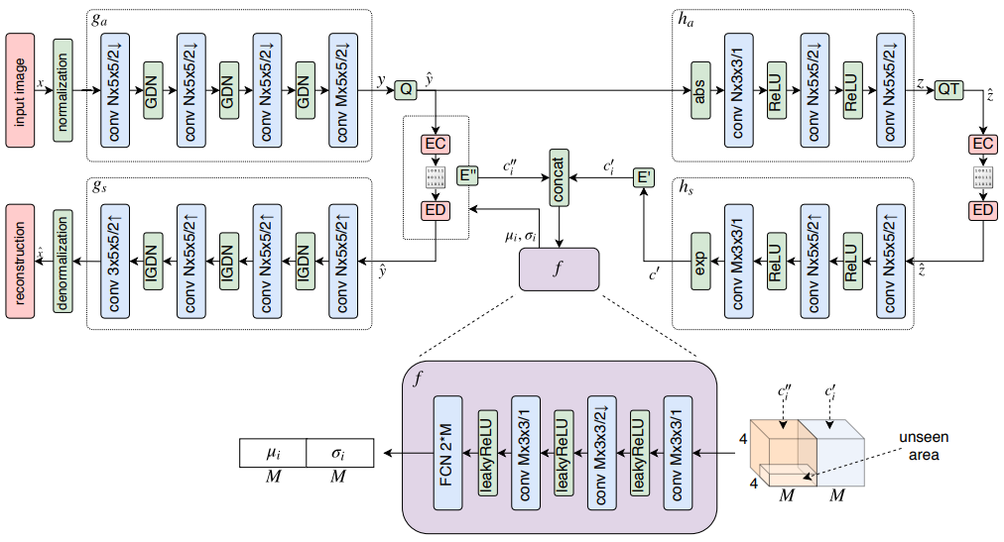
Learned Image Compression
CNN transformer + autoregressive entropy model ^{[5]}
[5] Lee, Jooyoung, et al. "Context-adaptive Entropy Model for End-to-end Optimized Image Compression." in ICLR. 2019.
Notes:
Almost at the same time, another autoregressive model was proposed by Lee et al., which has similar idea to the previous method (there’s an unseen area), but models the pmf of each channel with the same sigma and mu.
These are the popular CNN-based methods for learned compression. In the following, I will introduce some alternative strategies proposed in recent works.

Slide 12
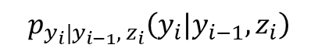
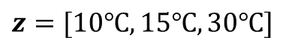
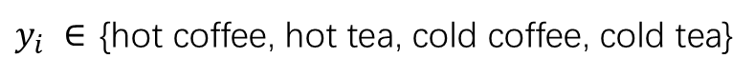



Learned Image Compression
$y_{i} ∈$ {hot coffee, hot tea, cold coffee, cold tea}
$${y=[y}_{1},{ y}_{2},{ y}_{3}]$$
Factorized entropy model
Hyperprior entropy model
Autoregressive entropy model (joint with hyperprior)
$p_{y_{i}}\left(y_{i}\right)=25\%$ for $y_{i}=$ hot coffee, hot tea, cold coffee, cold tea
$$H\left(p_{y_{i}}\right)=4×\left(−0.25\log_{2}{0.25}\right)=2$$
The expected number of bits to encode $y$ is 6
$$z=[10℃, 15℃, 30℃]$$
$p_{y_{i}|z_{i}}\left(y_{i}|z_{i}<20℃\right)=50\%$ for $y_{i}=$ hot coffee, hot tea
$$H=2×\left(−0.5\log_{2}{0.5}\right)=1$$
$p_{y_{i}|z_{i}}\left(y_{i}|z_{i}≥20℃\right)=50\%$ for $y_{i}=$ cold coffee, cold tea
$$H=1$$
The expected number of bits to encode $y$ is 3
Don’t drink coffee (or tea) in two consecutive days.
$$p_{y_{i}|y_{i−1}, { z}_{i}}\left(y_{i}|y_{i−1}, z_{i}\right)$$
$p(y=$ [hot coffee, hot tea, cold coffee]$)=0.5$
$$z=[10℃, 15℃, 30℃]$$
$p(y=$ [hot tea, hot coffee, cold tea]$)=0.5$
The expected number of bits to encode $y$ is $H(y)=2×\left(−0.5\log_{2}{0.5}\right)=1$

Slide 13




Learned Image Compression
Another differentiable quantization method ^{[4]}
Importance map ^{[4]}
Inference
Training: differentiable
=0
H
Channels
W
[4] Mentzer, Fabian, et al. “Conditional Probability Models for Deep Image Compression”, in CVPR, 2018.
[6] Cheng et al. ” Learned Image Compression with Discretized Gaussian Mixture Likelihoods and Attention Modules”, in CVPR. 2020.
Notes:
The first one is another way of differentiable quantization. They quantize values to the given centers c1 to cL. In inference, the values are assigned to its nearest center as the quantized value. When training, they adopt a soft quantization method, which is expressed as this. Besides, they use a smart trick, i.e., use the actual quantized value in forward computation, but uses the gradient of the soft quantization in back propagation. The second is to learn an important map to flexibly allocate bit-rates, e.g., the latents for background can have fewer channels, and that for edges and complex textures may have more channels. This important map is learned to decide how many channels should be kept and how many should be discarded.

Slide 14


Learned Image Compression
Another differentiable quantization method ^{[4]}
Importance map ^{[4]}
Inference
Training: differentiable
Gaussian Mixture Model (GMM) for entropy ^{[6]}
[4] Mentzer, Fabian, et al. “Conditional Probability Models for Deep Image Compression”, in CVPR, 2018.
[6] Cheng et al. ”Learned Image Compression with Discretized Gaussian Mixture Likelihoods and Attention Modules”, in CVPR. 2020.
Notes:
Then, Cheng et al., proposed the GMM entropy model, which models the distribution more flexibly via the gaussian mixture model.

Slide 15

Learned Image Compression
CNN transformer + coarse-to-fine model ^{[7]}
[7] Hu, Yueyu, et al. "Coarse-to-Fine Hyper-Prior Modeling for Learned Image Compression." in AAAI. 2020.
Notes:
Most recently, the coarse-to-fine entropy model is proposed. It employs 3 hierarchical layers, the third layer provides the estimated distribution of the second layer, and the second layer further provides that for the first layer.

Slide 16


Learned Image Compression
Performance
Coarse-to-fine
Coarse-to-fine
The rank may vary on different datasets
The context (autoregressive) and coarse-to-fine models outperform BPG 4:4:4 (latest traditional standard)
Notes:
These are the rate-distortion performances compared with the latest traditional codes BPG 444. It can be seen that the auto-regressive and the coarse-to-fine models outperform BPG. However, things may be different on another dataset. On Tecnick, only the coarse-to-fine beats BPG. This may be because the generalization capability of learned methods are not as good as the traditional methods, since the learned methods may depend on training data.
In above methods, each operating point needs to train one model, so many models need to be trained to achieve various bit-rates. In the following, we will introduce how to achieve variable bit-rates with one model.

Slide 17


Learned Image Compression
Variable rate image compression: RNN-based methods ^{[8, 9]}
1-st iteration
2-nd iteration
Improve
······
N-th iteration
[8] Toderici, George, et al. "Variable Rate Image Compression with Recurrent Neural Networks." in ICLR. 2016.
[9] Toderici, George, et al. “Full Resolution Image Compression with Recurrent Neural Networks.” in CVPR, 2017.
Notes:
The first way is to utilize the recurrent neural network based auto-encoder. The basic idea is recurrently compressing the residuals, e.g., after the 1st iter, we can obtain a residual, and this residual is compressed in the 2nd iter, and then the residual is further compressed in the 3rd iter, and so on. In the shown framework, the target bit-rate is 16 bits for the input path, then stop at the 4-th iter. There is an improved version, with deeper encoder and decoder, i.e., 3 RNN cells in the encoeder and 4 RNN cells in the decoder.

Slide 18



Learned Image Compression
Variable rate image compression: RNN-based methods ^{[10]}
Basic framework
Increasing the depth of neural network
[10] Johnston, Nick, et al. “Improved Lossy Image Compression with Priming and Spatially Adaptive Bit Rates for Recurrent Networks.” in CVPR. 2018.

Slide 19







Learned Image Compression
Variable rate image compression: Conditional autoencoder ^{[11]}
Loss function:
[11] Choi, Yoojin, et al. “Variable Rate Deep Image Compression With a Conditional Autoencoder.” in ICCV. 2019.
Notes:
Another way to achieve variable bit-rates is the conditional auto-encoder. In the normal loss function, lambda is used to balance the rate and distortion terms. In the conditional auto-encoder, they input lambda into the auto-encoder, and therefore the auto-encoder is able to generate the expected bit-rate according the lambda. This way, the loss is the sum of all possible lambdas to optimize all possible operational points. To make it more flexible, they also quantize the latents with variable steps, 0.5 to 2, larger step leads to lower bit-rate. The final loss is the sum (or expectation) among all lambdas and deltas. This figure shows the results, note that all these curves are achieves via one pre-trained model.

Slide 20

Learned Image Compression
Variable rate image compression: Conditional autoencoder ^{[11]}
[11] Choi, Yoojin, et al. “Variable Rate Deep Image Compression With a Conditional Autoencoder.” in ICCV. 2019.
Notes:
This is the comparison with previous methods. It can be seen that the variable rate method has comparable performance with previous methods. However, previous methods learn a model for each point. This method uses one model for all points.

Slide 21



Learned Image Compression
Variable rate image compression: Wavelet-like transformer ^{[12]}
Q
Invertible: achieving lossy and lossless compression by the same framework
[12] Ma, Haichuan, et al. “End-to-End Optimized Versatile Image Compression With Wavelet-Like Transform.” in IEEE T-PAMI. 2020.
Notes:
The last method is an invertible auto-encoder. In all above methods, the auto-encoders are not invertible, i.e., even without quantization, the output cannot be lossless. In this method, they use a wavelet-like network, which is invertible like DCT and DWT. If we use the same P1 U1 in both encoder and decoder sides, it ensures that the networks are invertible. This way, the quality loss only comes from quantization. If we quantize the latents with large step, the bit-rate will be lower. If we do not quantize it, it will be lossless. Therefore, this framework is able to achieve variable bit-rates and even lossless compression via one framework and (or) one trained model. In practice, they use the 2D split network to transform the image and compress in the zigzag order.

Slide 22

Learned Image Compression
Variable rate image compression: Wavelet-like transformer ^{[12]}
(one model for each point)
(one model for all points)
one model for both lossy and lossless compression
[12] Ma, Haichuan, et al. “End-to-End Optimized Versatile Image Compression With Wavelet-Like Transform.” in IEEE T-PAMI. 2020.
Notes:
The curve with rectangular points is result of training different models for different points, and this curve all the rectangular points are obtained by training only one model. Furthermore, they can achieve lossy and lossless even with one model.

Slide 23





Learned Image Compression
Generative image compression: GAN-based methods ^{[13]}
Encoder
Decoder
(Generator)
Discriminator
GAN loss
RD loss
[13] Agustsson, Eirikur, et al., "Generative adversarial networks for extreme learned image compression." in ICCV. 2019.

Slide 24



Learned Image Compression
Generative image compression: GAN-based methods ^{[13]}
Conditional GAN:
Selective generative compression (SC):
[13] Agustsson, Eirikur, et al. "Generative adversarial networks for extreme learned image compression." in ICCV. 2019.

Slide 25


Learned Image Compression
Generative image compression: GAN-based methods ^{[14]}
Conditional discriminator:
[14] Mentzer, Fabian, et al. "High-Fidelity Generative Image Compression." in NeurIPS. 2020.

Slide 26

Learned Image Compression
Generative image compression: GAN-based methods ^{[14]}
[14] Mentzer, Fabian, et al., "High-Fidelity Generative Image Compression." in NeurIPS. 2020.

Slide 27
Learned Image Compression
Coarse-to-fine
Conclusion:
CNN-based methods
Factorized entropy model
Hyperprior entropy model
Autoregressive entropy model
Coarse-to-fine entropy model
Conditional auto-encoder (variable bit-rates)
Invertible auto-encoder (lossy and lossless by one framework)
RNN-based methods
Variable bit-rate
GAN-based methods
Photo-realistic compressed image with low bit-rate
Coarse-to-fine
The state-of-the-art learned image compression methods successfully outperform the latest traditional compression standard BPG 4:4:4

Slide 28

Learned Image Compression
Will learning-based compression be standardized?
Can learning-based method be compatible with traditional standards (e.g., JPEG)?

Slide 29

Learned Image Compression
Will learning-based compression be standardized?
Can learning-based method be compatible with traditional standards (e.g., JPEG)?
We made an attempt: ^{[15]}
Frequency domain pre-editing
Compatible with standard decoder
[15] Strümpler, Yannick, et al. "Learning to Improve Image Compression without Changing the Standard Decoder." in ECCVW. 2020.

Slide 30

Learned Image Compression
Will learning-based compression be standardized?
Can learning-based method be compatible with traditional standards (e.g., JPEG)?
We made an attempt: ^{[15]}
[15] Strümpler, Yannick, et al. "Learning to Improve Image Compression without Changing the Standard Decoder." in ECCVW. 2020.

Slide 31
Learned Image Compression
Will learning-based compression be standardized?
Can learning-based method be compatible with traditional standards (e.g., JPEG)?
We made an attempt: ^{[15]}
Frequency domain pre-editing
Compatible with standard decoder
We achieve better rate-distortion performance without changing the standard decoder
The compressed image can be decoded (viewed) on any common device, e.g., mobile, ipad, PC, etc.
[15] Strümpler, Yannick, et al. "Learning to Improve Image Compression without Changing the Standard Decoder." in ECCVW. 2020.

Slide 32
Learned Image Compression
Open source codes:
Ballé et al., (factorized), Ballé et al., (hyperprior):
https://github.com/tensorflow/compression (TensorFlow)
Ballé et al., (factorized), Ballé et al., (hyperprior), Minnen et al., (autoregressive):
https://interdigitalinc.github.io/CompressAI/index.html (PyTorch)
Lee et al., (context-adaptive):
https://github.com/JooyoungLeeETRI/CA_Entropy_Model
Mentzer et al., (autoregressive + importance map):
https://github.com/fab-jul/imgcomp-cvpr
Cheng et al., (GMM entropy model):
https://github.com/ZhengxueCheng/Learned-Image-Compression-with-GMM-and-Attention
Hu et al., (coarse-to-fine):
https://github.com/huzi96/Coarse2Fine-ImaComp
Ma et al., (wavelet-like transformer):
https://github.com/mahaichuan/Versatile-Image-Compression
Mentzer et al., (generative compression):
https://github.com/tensorflow/compression/tree/master/models/hific
Notes:
These are the open-sourced codes of aforementioned works. The first two are the most popular, i.e., the official tensorflow codes for balle’s codes, and an unofficial pytorch implementation of that including the auto-regressive method.

Slide 33
Learned Image Compression
Thanks for your attention
Q & A
Dong Xu
University of Sydney, Australia
dong.xu@sydney.edu.au
Guo Lu
Beijing Institute of Technology, China
luguo2014@sjtu.edu.cn
Ren Yang
ETH Zurich, Switzerland
ren.yang@vision.ee.ethz.ch
Radu Timofte
ETH Zurich, Switzerland
radu.timofte@vision.ee.ethz.ch

